Slide 1
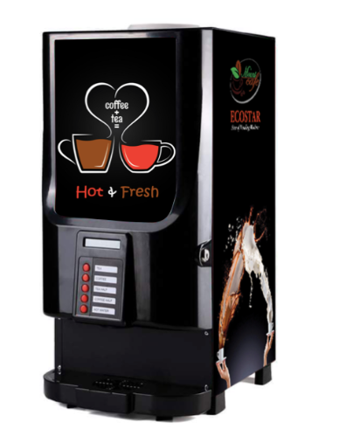
Drinks Vending Machine
System
By:
Jasmeet Singh Matta
Jaouaher Belgacem
Evrard Leuteu Feukeu

Slide 2

MOTIVATION

Slide 3
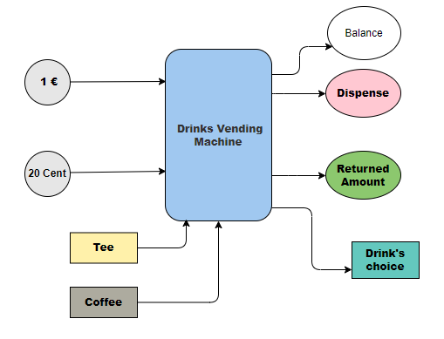
System’s Concept
Block Diagram

Slide 4
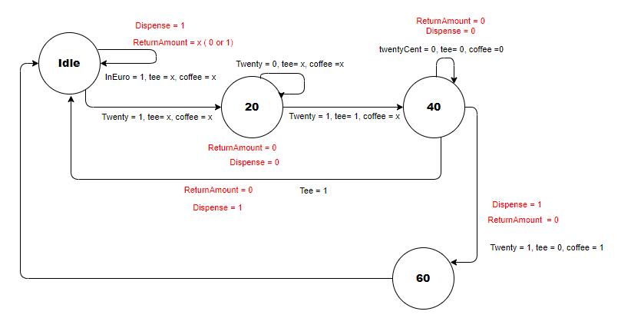
System’s Concept
FSM Diagram

Slide 5
VHDL Part
Three Processes’ Method:
State Memory Process
Next_State Process
Output Process

Slide 6
TestBench Description
Objective: This project is to be implemented in VHDL, using the main clock of the Digilent Board to drive the state machine. The layout is as follows.
The vending machine has the following inputs:
Clock: A clock signal used to drive the finite state machine (FSM).
Reset: A signal used to reset the FSM to its initial state.
euroIn: An input signal indicating the insertion of a euro coin.
twentyCent: An input signal indicating the insertion of a twenty-cent coin.
tee: An input signal indicating the selection of tea as a drink.
coffee: An input signal indicating the selection of coffee as a drink.
The vending machine has the following outputs:
returnAmount : a signal that goes high when a single quarter has been accepted.
Balance: a signal that goes high when a drink has been dispensed
drinksChoice: A 2-bit vector output representing the chosen drink(s).

Slide 7
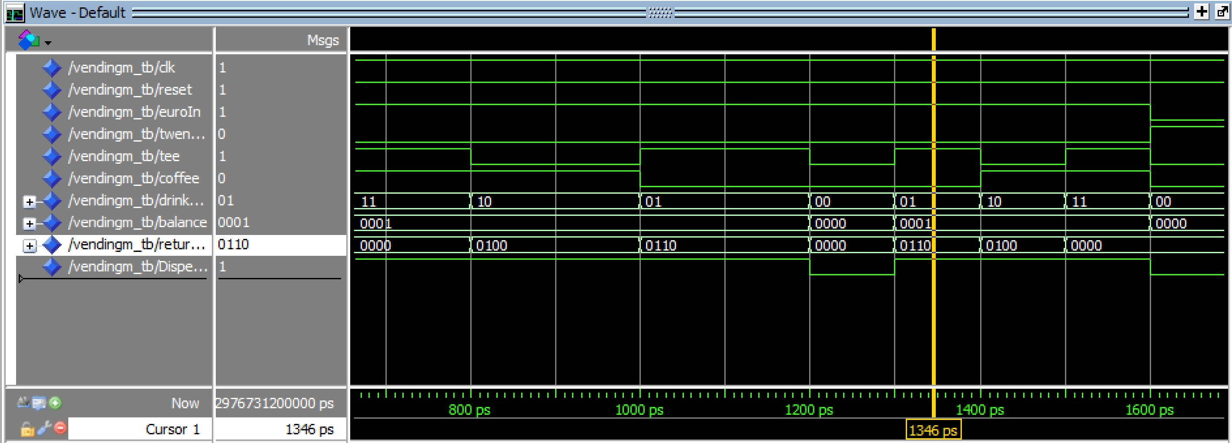
TestBench Simulaion

Slide 8
TestBench
CASES | INPUTS | BEHAVIOR
Test case 1: Choose tea (40 cents) | euroIn = ‘1’, twentyCent = '0’ tee = '1’ , coffee = '0' | DispenseD signal(‘1’) drinksChoice : tea (’10’) The balance :40 cents(‘0100’). The returnAmount is unchanged.
Test case 2: Choose coffee (60 cents) | euroIn = ‘1’ , twentyCent = '0’ tee = ‘0’, coffee = '1' | DispenseD signal(‘1’) drinksChoice (coffee) The balance :60 cents(‘0110’). The returnAmount is unchanged.
Test case 3: Choose tea (40 cents) and coffee (60 cents) | euroIn = ‘1’ , twentyCent = '0’ tee = ‘1’, coffee = '1' | DispenseD signal(‘1’) drinksChoice (‘11’) The balance (‘0’). The returnAmount is unchanged.
Test case 4: Insert 20 cents (no drink chosen) | euroIn = ‘0’ , twentyCent = ‘1’ tee = ‘0’, coffee = ‘0' | DispenseD signal(‘0’) drinksChoice (’00’) The balance (‘0’). The returnAmount is unchanged.

Slide 9
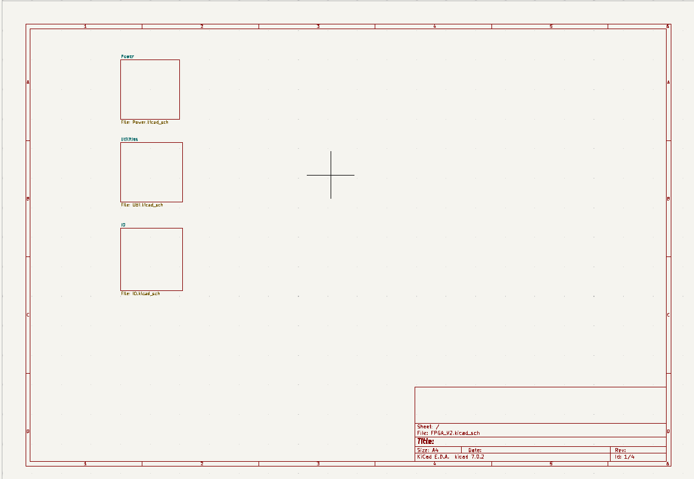
PCB Part
Schematic

Slide 10
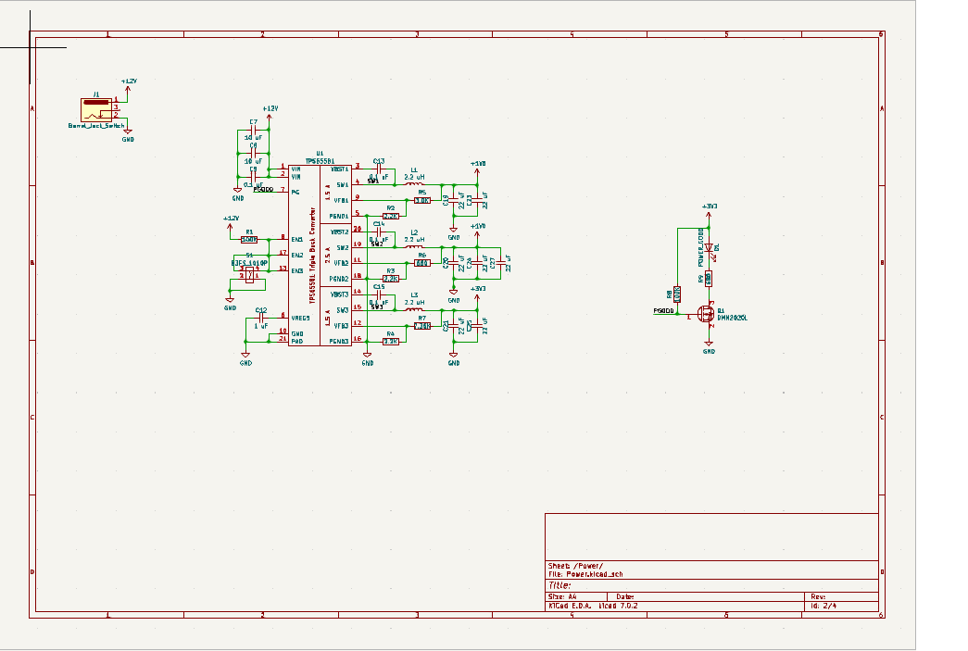
PCB Part
Schematic

Slide 11
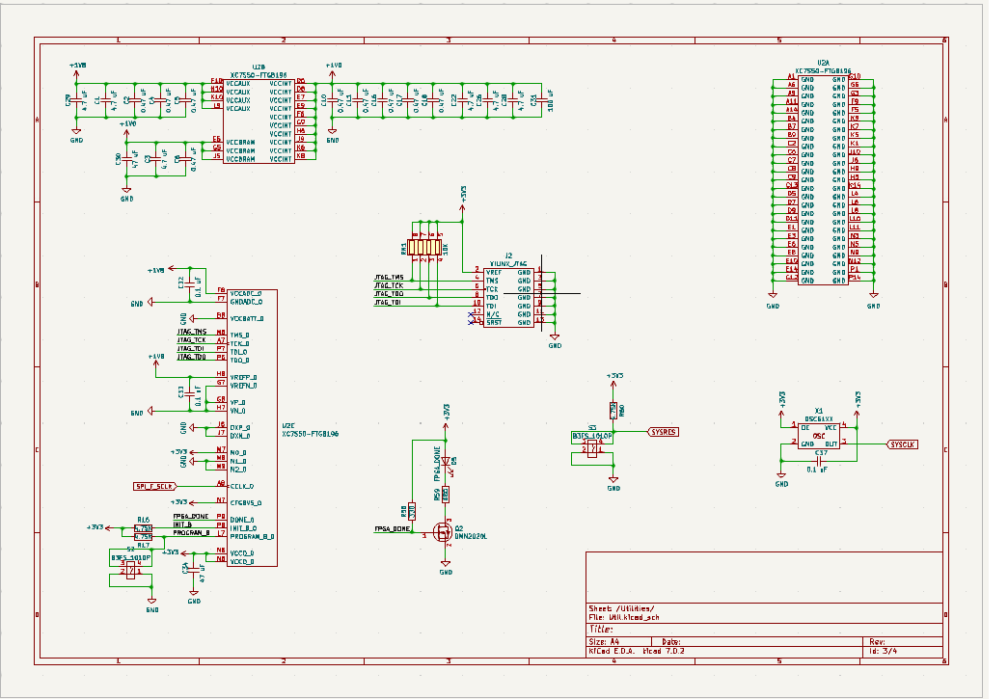
PCB Part
Schematic

Slide 12
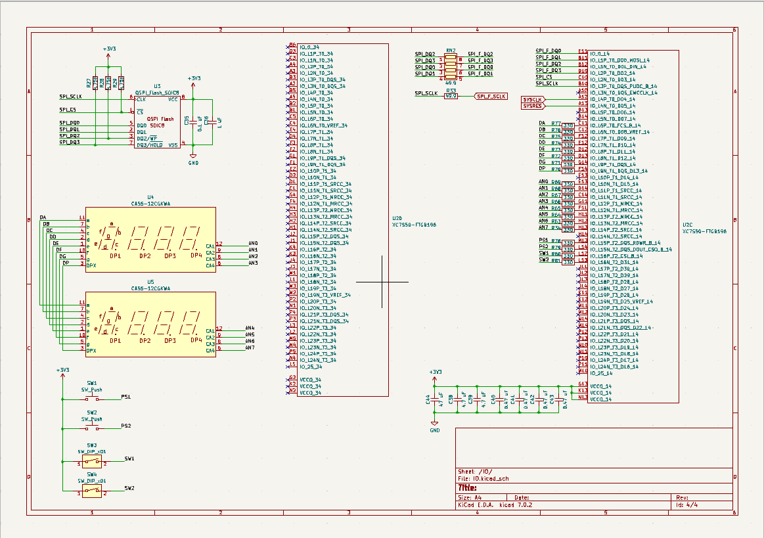
PCB Part
Schematic

Slide 13
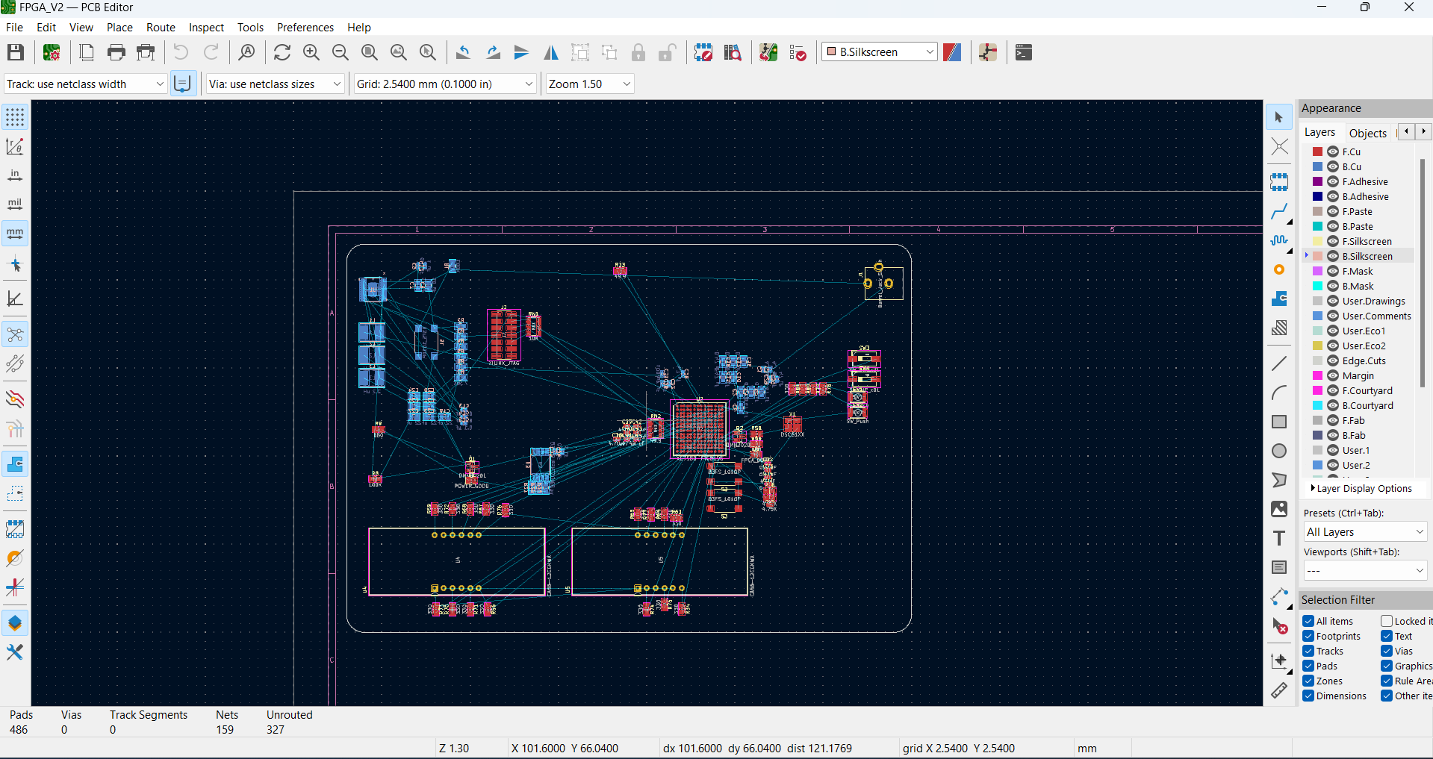
PCB Part
PCB-Layout

Slide 14
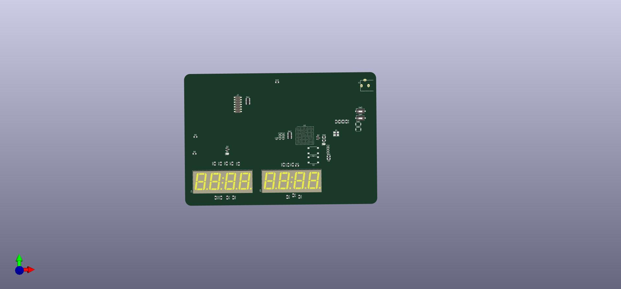
PCB Part
3D View

Slide 15
REAL Time Testing of the System

Slide 16
Thank you

